Slide 1
Air Flight Data: Delayed New Years Flights
By
Jeffrey Lam
Chris Alipio
Fiona Tang
Andrew Tran
Sean Pattarateranon
CSULA Fall 2019 / CIS3200: Data Processing & Analytics
Professor Jongwook Woo, Ph.D.

Slide 2
ABSTRACT
Airline delays have become under increased scrutiny lately among travelers and popular press. Flight delays are caused by several attributes such as airport congestion, airspace congestion, weather and customer disturbance. We will be using Airline Delay and Cancellation Data, 2016 - 2018 Flight info. of US domestic flights. Our focus is to analyze and predict future cancellations of flights and delays during the New Year's holiday. The years we base our datasets will be between 2016-2018 with additional information implementation of machine learning. By doing this, we will demonstrate regression lines for cancellation flights and top 15 destination flights.

Slide 3
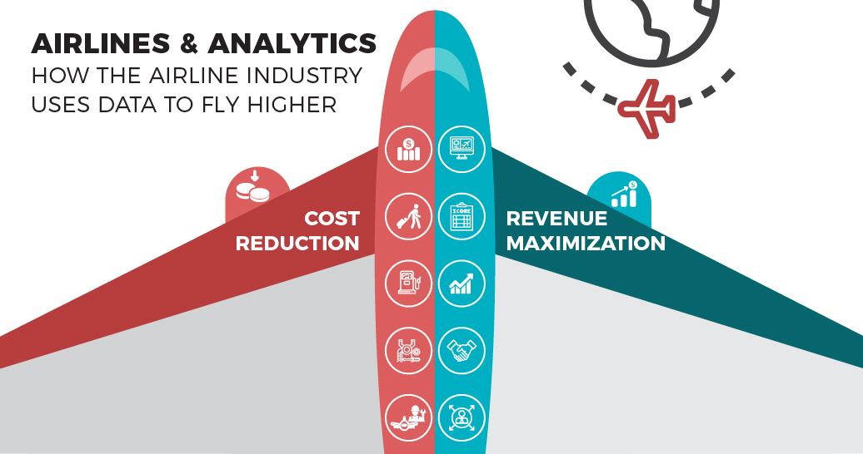
INTRODUCTION

Slide 4
PROBLEM STATEMENT
Thousands of travelers on some of the largest airlines endure long waits throughout every season, as their flights are delayed or canceled due to unforeseen conditions. When flights are canceled or delayed, passengers may be entitled to compensation due to rules obeyed by every flight company.

Slide 5
PLATFORM SPECIFICATIONS
Intel(R) Core (™) i7-2600k
CPU Speed: 3.40 Ghz
Number of CPU cores: 8
Total Memory Size: 8GB RAM

Slide 6
DATASET & ANALYSIS TOOLS
Dataset
Airline Delay and Cancellation (2016-2018) from www.kaggle.com (detailed URL in next slide)
Analysis Tools
Microsoft Azure Machine Learning Studio
Tableau

Slide 7
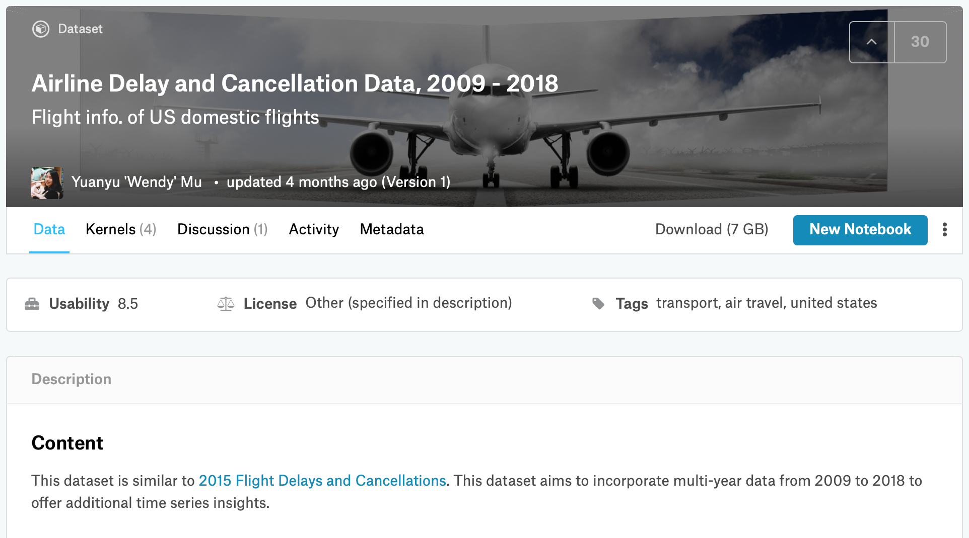
DATASET ORIGIN
https://www.kaggle.com/yuanyuwendymu/airline-delay-and-cancellation-data-2009-2018

Slide 8
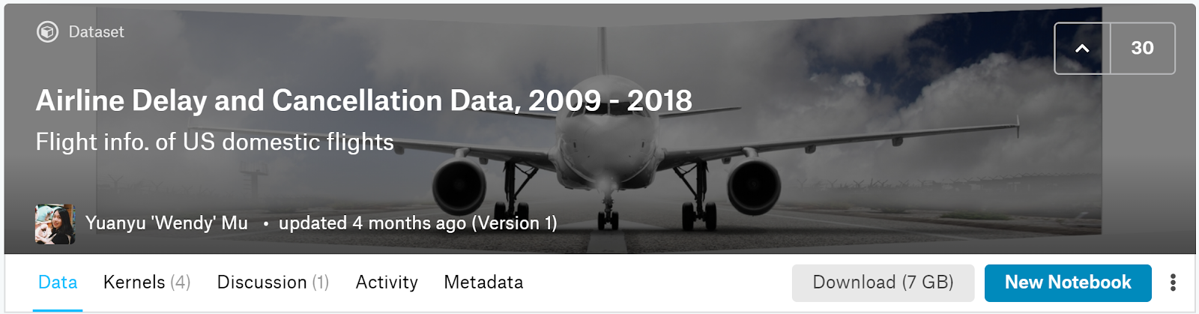
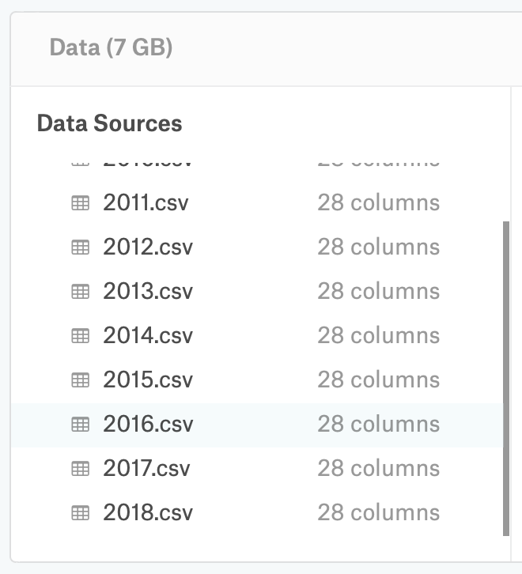
ORIGINAL SIZE OF DATASET
7 GB (2009-2018) → 2 GB (2016-2018)

Slide 9
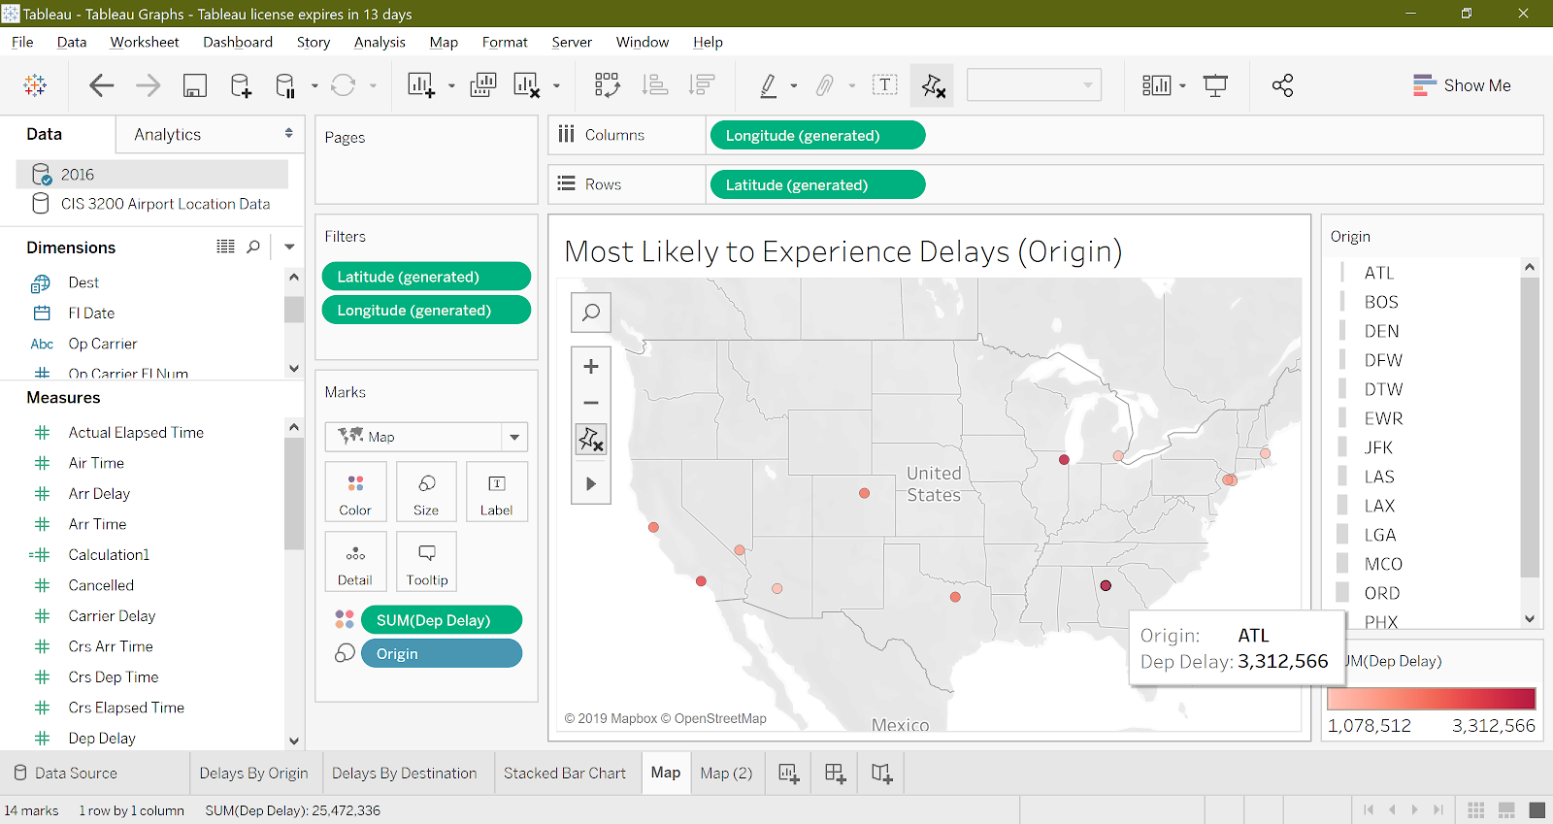

Slide 10
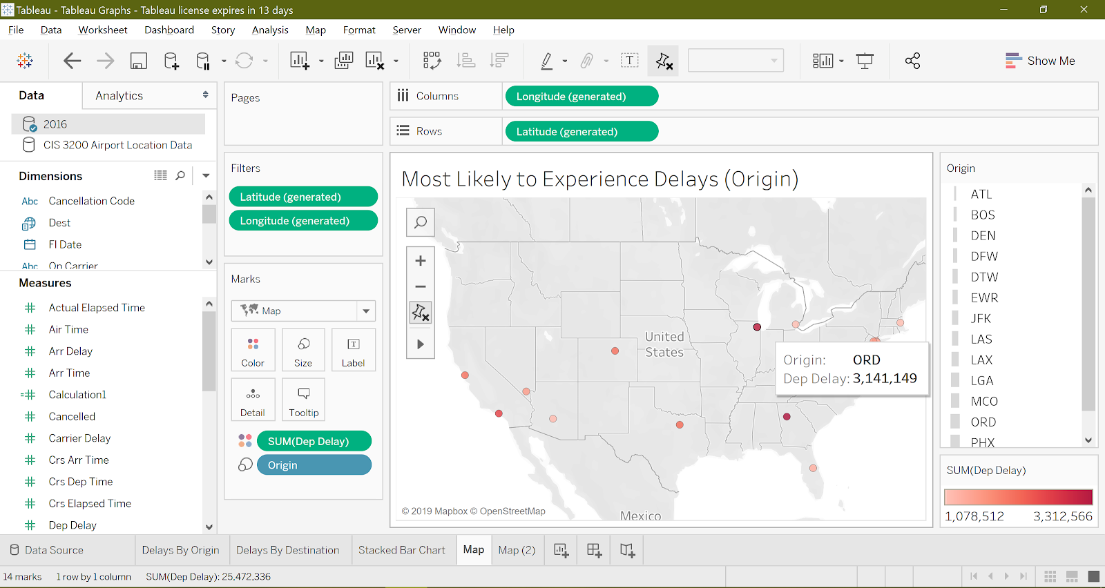

Slide 11
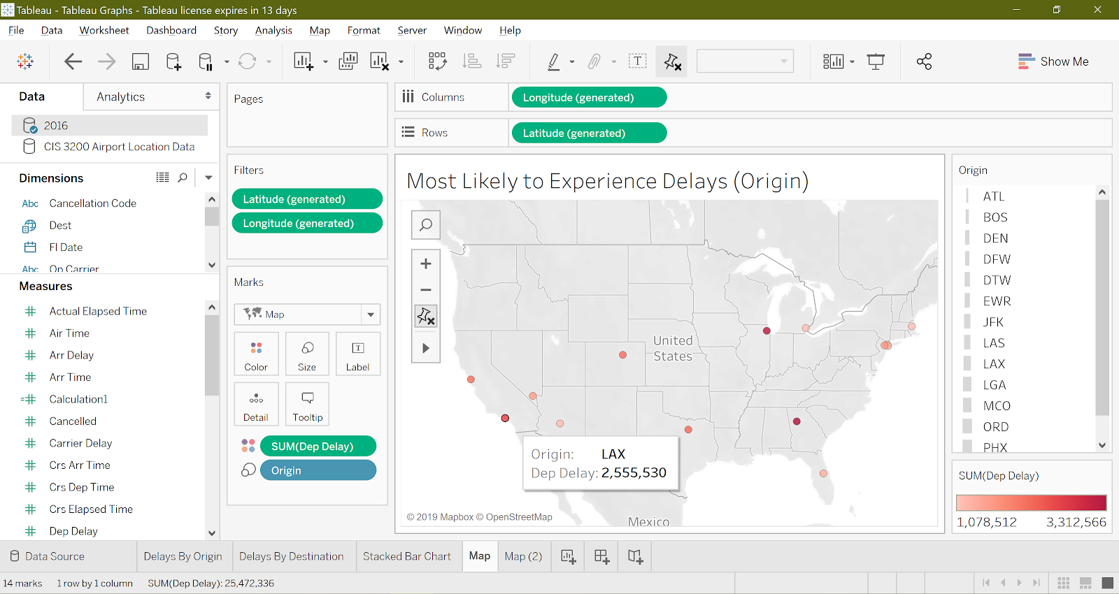

Slide 12
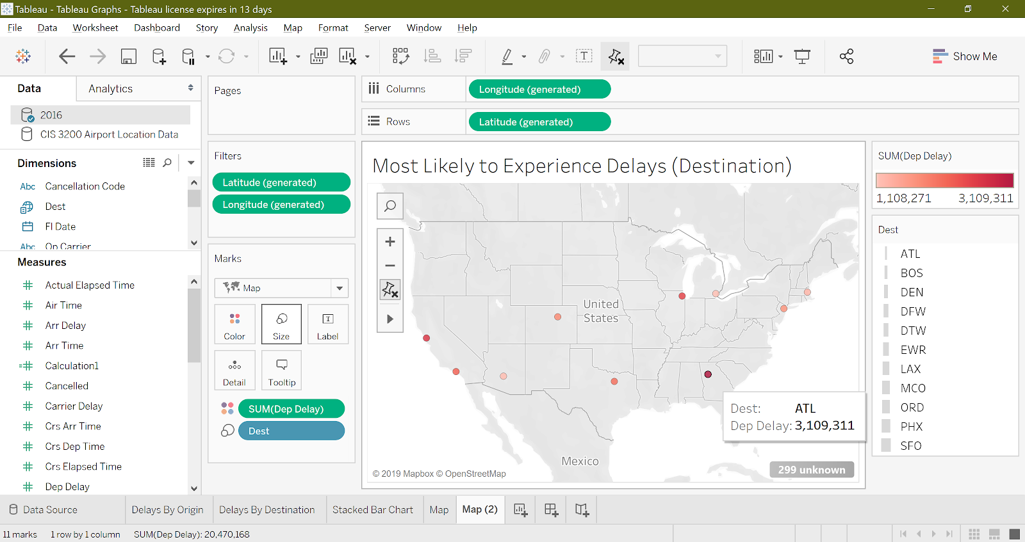

Slide 13
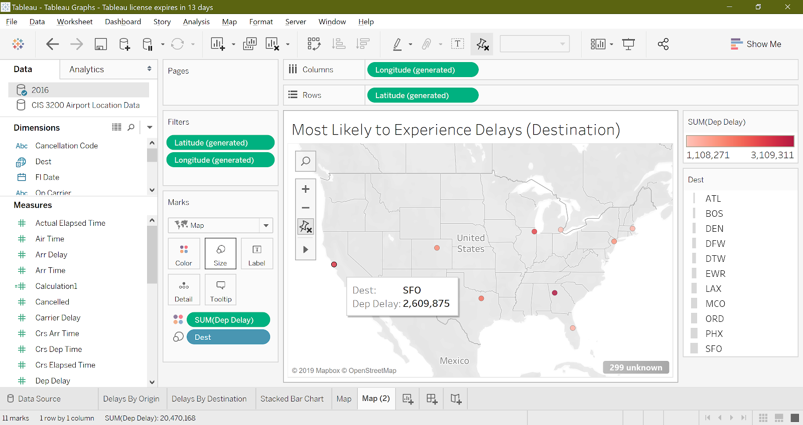

Slide 14
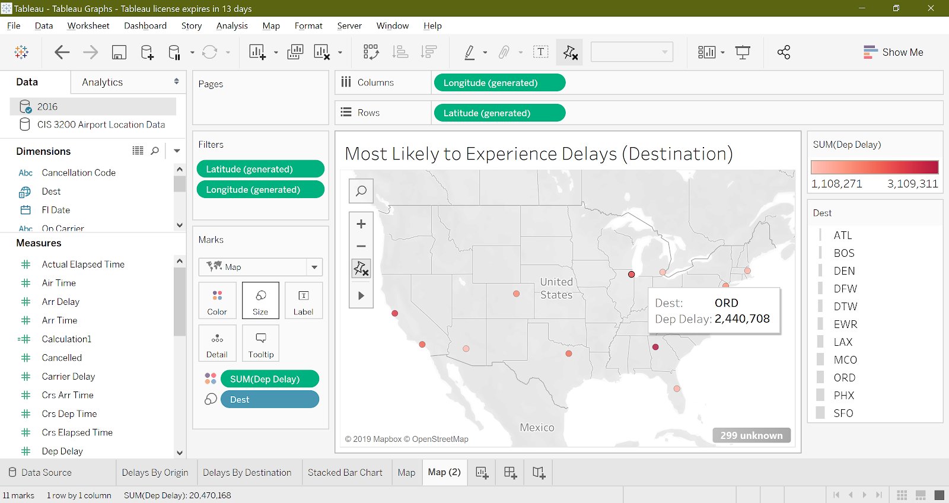

Slide 15
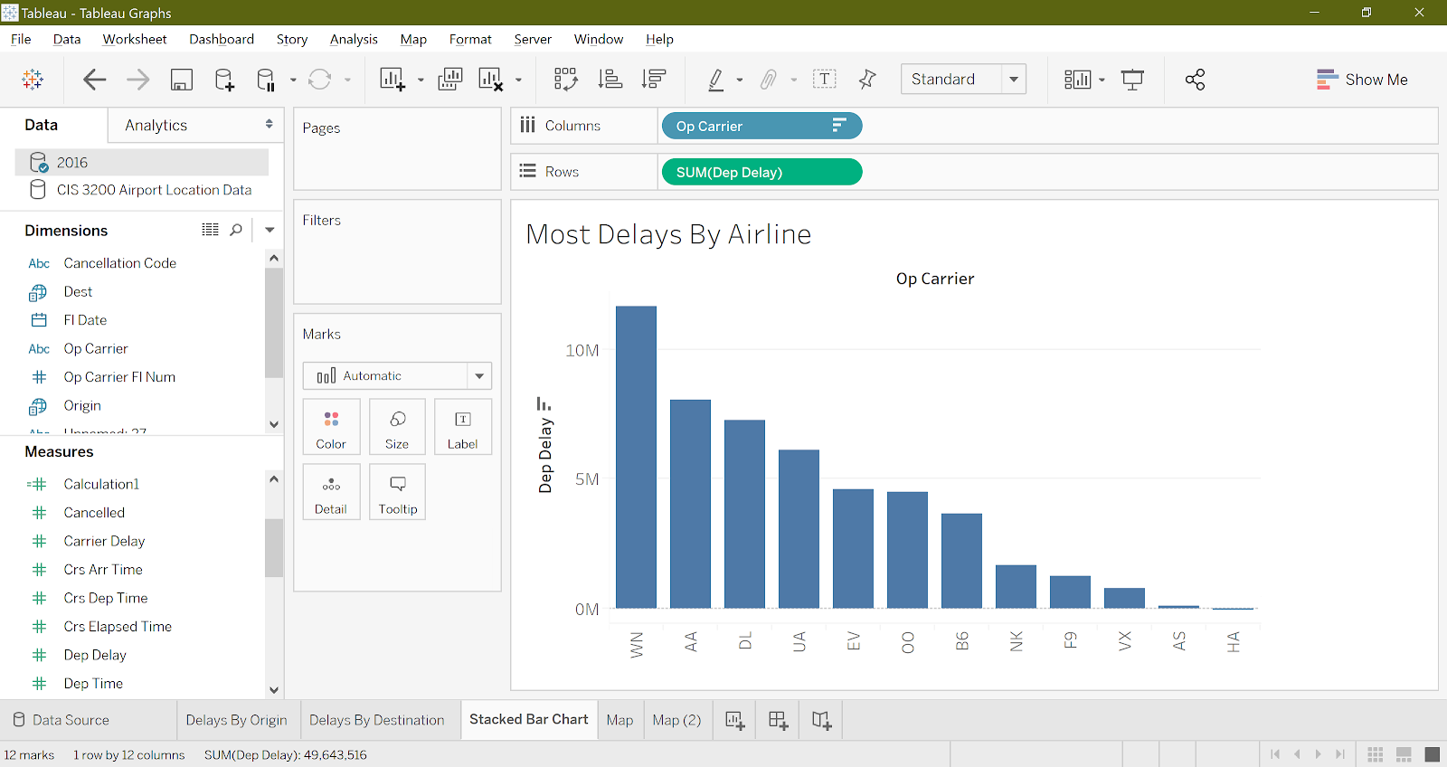
DATASET ORIGIN

Slide 16
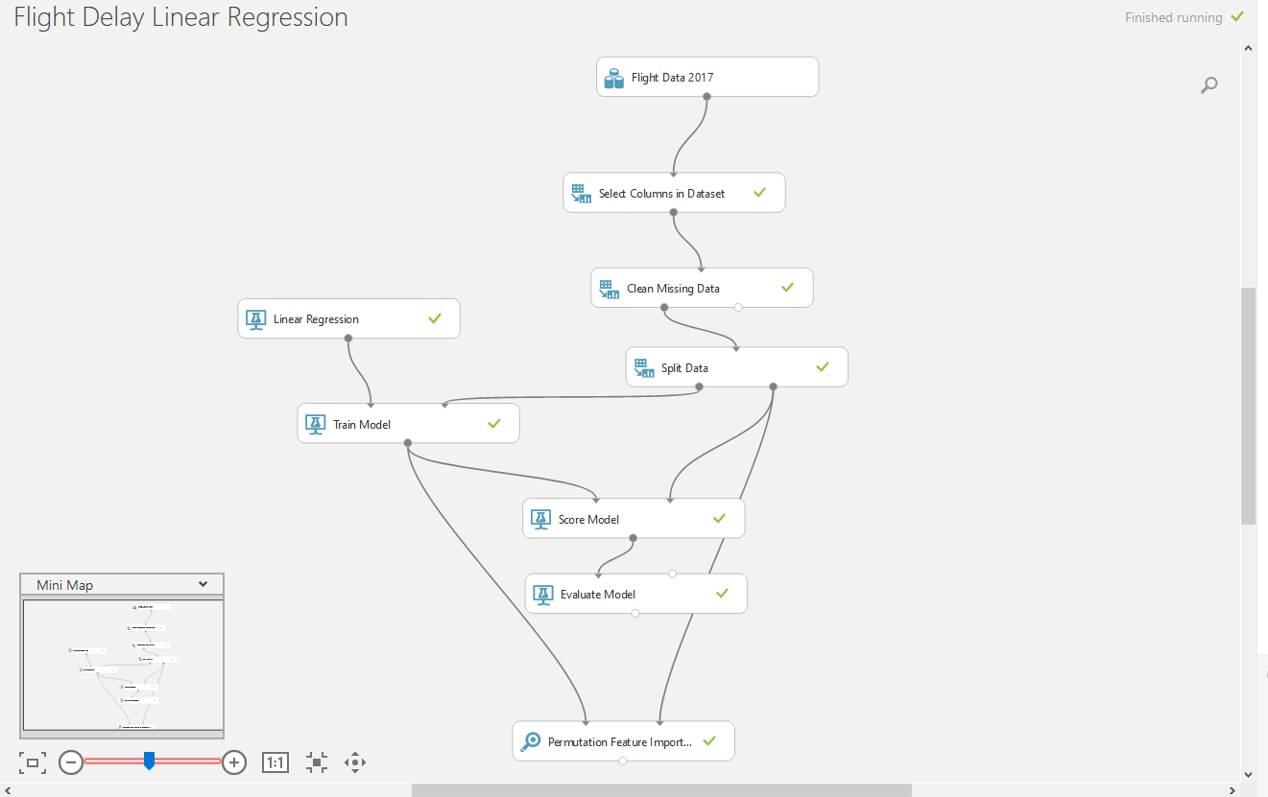
AZURE ML VISUALIZATIONS (Linear Regression)

Slide 17
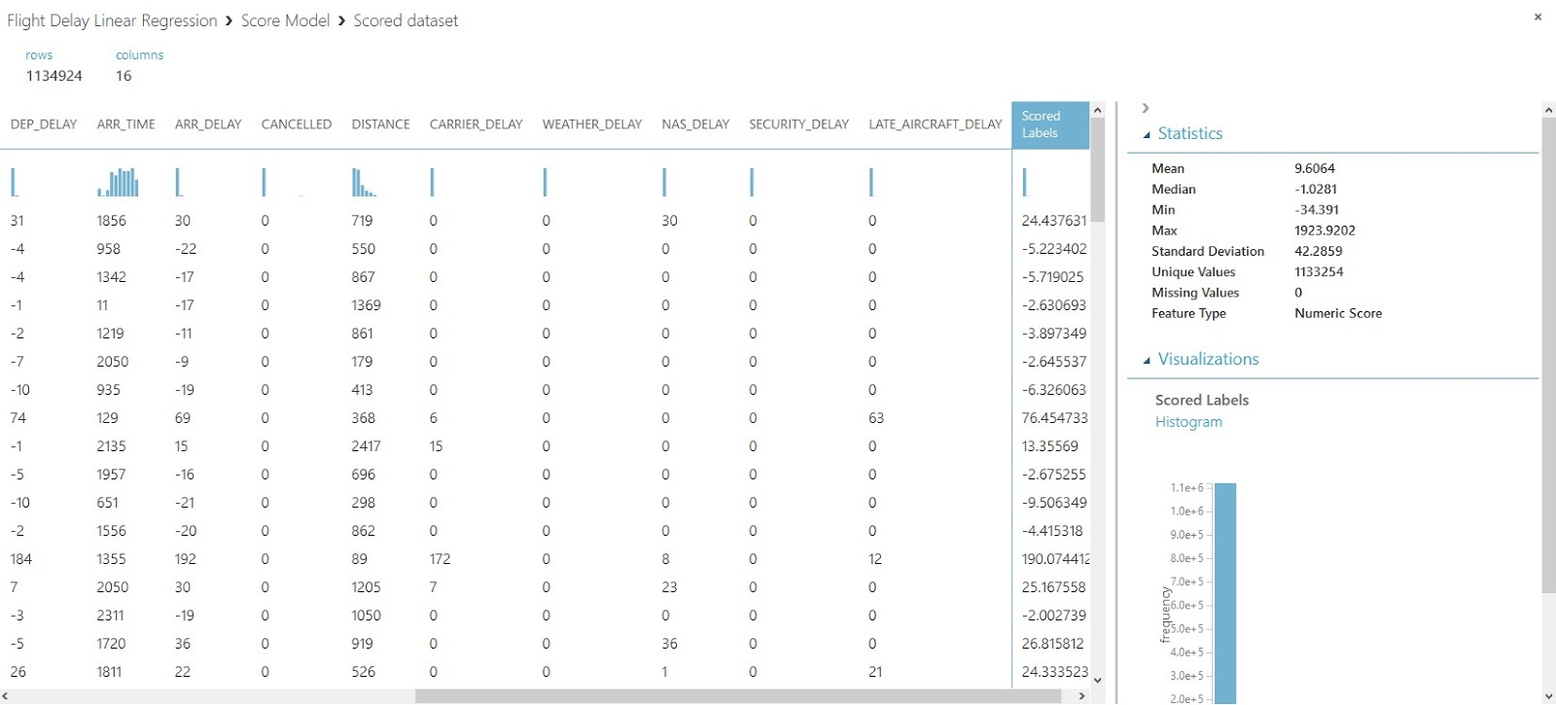
AZURE ML VISUALIZATIONS (Linear Regression)
Scored Labels predicts departure delays

Slide 18
DATASET ORIGIN (Linear Regression)
The causal factors for departure delays being tested are:
Flight date
Carrier
Flight origin and destination
Departure time and delay
Arrival time and delay
Cancellations
Distance
Carrier delay
Late aircraft delay
Weather/NAS/security delays.

Slide 19
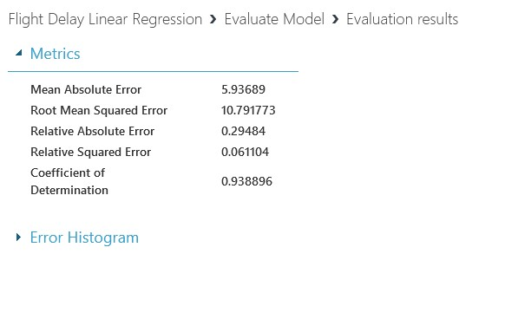
AZURE ML VISUALIZATIONS (Linear Regression)
The model we built is very accurate
RMSE of 10.79
Coefficient of Determination of 0.93

Slide 20
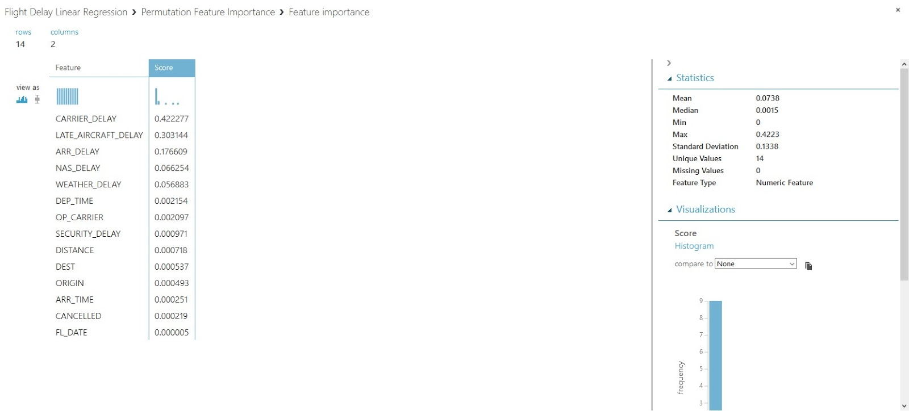
AZURE ML VISUALIZATIONS (Linear Regression)
The model found that the highest contributing variables are carrier delay, late aircraft delays, arrival delays, NAS delays, and weather delays.

Slide 21
HIGHEST CONTRIBUTION VARIABLES
Carrier delays are delays caused by things like aircraft cleaning, cargo loading, refueling, inspection, etc.
Late aircraft delays are simply just aircrafts that arrive at a later time than expected
Arrival delays refer to aircrafts that are late due to having been late to a previous airport
NAS delays are delays within the control of the National Airspace System. This includes factors such as airport operations, heavy traffic volume, air traffic control, etc.
Weather delays refer to extreme or hazardous weather conditions

Slide 22
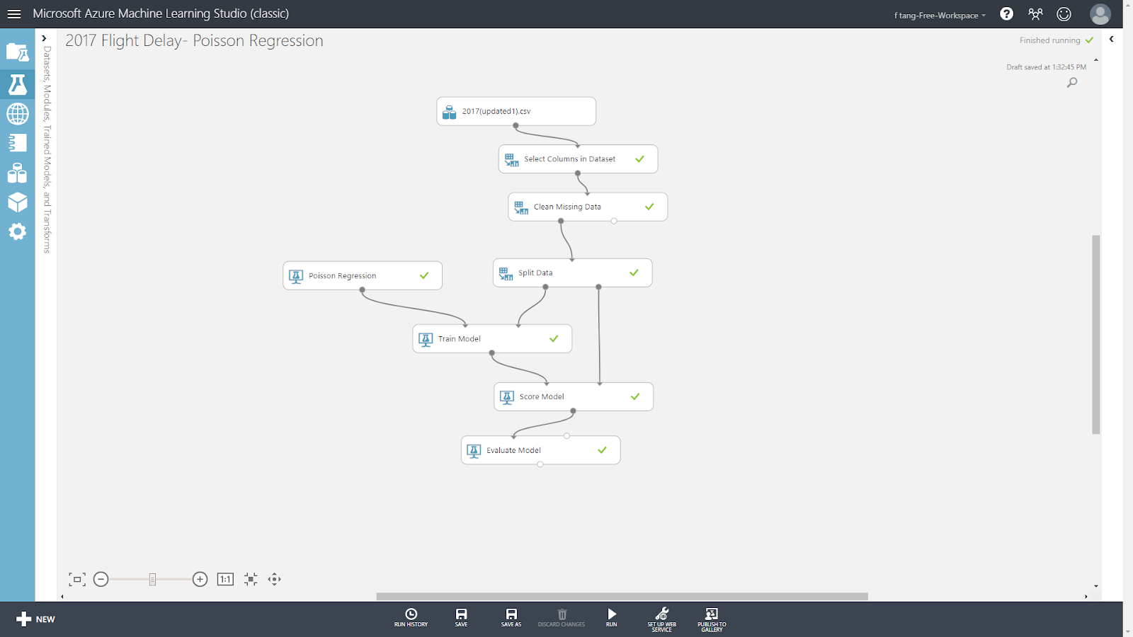
AZURE ML VISUALIZATIONS (Poisson Regression)

Slide 23
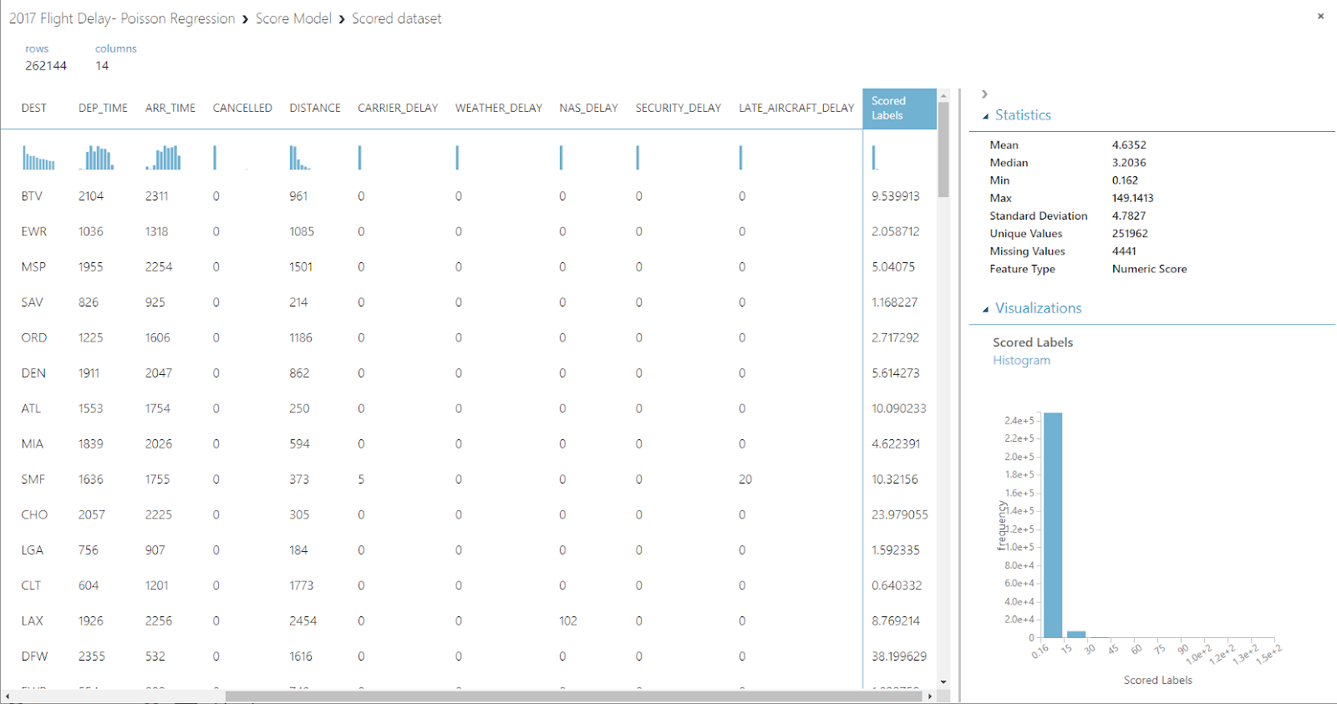
AZURE ML VISUALIZATIONS (Poisson Regression)

Slide 24
DATASET ORIGIN (Poisson Regression)
The causal factors for departure delays being tested are:
Flight date
Carrier
Flight origin and destination
Departure time
Arrival time
Cancellations
Distance
Carrier delay
Late aircraft delay
Weather/NAS/security delays.

Slide 25
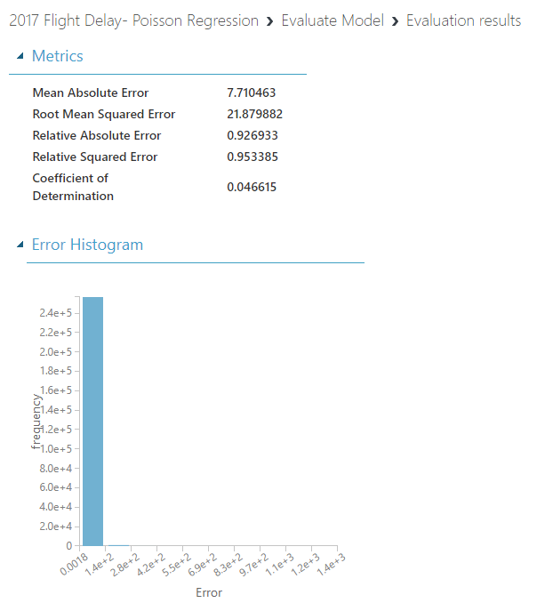
AZURE ML VISUALIZATIONS (Poisson Regression)
Model predictions are off by approximately 7.7 minutes
Coefficient of Determination of 0.04
It indicates a weak predicting power

Slide 26
CONCLUSION
The result data from the experiments which predicts U.S. domestic flights delays
The main concentration is done on Analytics platform and Data Visualization.
We have used Tableau to implement and visualize the dataset to provide users a better understanding for this project (interactive graphs, bars, maps)
We have built models of Machine Learning algorithms, and we have completed process of modeling, training, testing, and evaluating of the experiments.
Linear Regression model has Coefficient of Determination result of 0.93, which interpret that this analysis from dataset is 93% predictable; on the other side, Poisson Regression model has a result of 0.04 which mean only 4% is predictable. As a result, Linear Regression model has yield a better result of 93% which is accurate.

Slide 27
REFERENCES & LINKS
https://www.kaggle.com/yuanyuwendymu/airline-delay-and-cancellation-data-2009-2018
Cheng, S., Zhang, Y., Hao, S., Liu, R., Luo, X., & Luo, Q. (2019). Study of Flight Departure Delay and Causal Factor Using Spatial Analysis. Journal of Advanced Transportation, 2019, 1–11. doi: 10.1155/2019/3525912
Ma, S., Wang, X., & Hu, H. (2017). Research on Flight Delay Based on Fuzzy Evaluation Algorithm. Journal of Applied Mathematics and Physics, 05(10), 1923–1937. doi: 10.4236/jamp.2017.510163

Slide 28
REFERENCES & LINKS
GitHub
https://github.com/spatta983/CIS3200-Group4
Azure ML (Linear Regression)
https://gallery.cortanaintelligence.com/Experiment/Flight-Delay-Linear-Regression
Azure ML (Poisson Regression)
https://gallery.cortanaintelligence.com/Experiment/2017-Flight-Delay-Poisson-Regression

